Slide 1
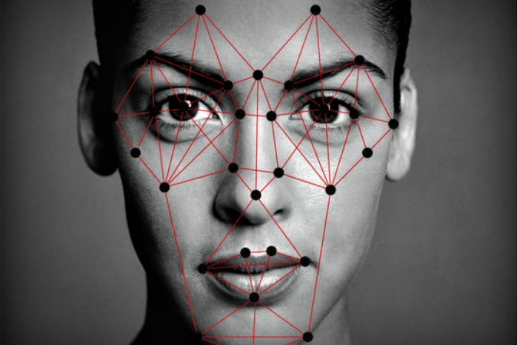
Who really?
A facial recognition system for the common user
Jonas Schumacher
Kathryn Cook
Tyler Paquet
Daniel Wynalda
http://www.techtweakerz.com/wp-content/uploads/2017/10/facial-recognition-featured.jpg

Slide 2
Purpose
Create an application that:
Receives a portrait
→ personally and easily selected by a user
Uses specially trained neural networks created with machine learning
Analyzes for 3 different facial features
Has a site-hosted client and server, as well as local and CLI options
Reports results in a readable format back to the user
Warning: The system does not filter for non-human or non-portrait images. If an inappropriate picture is selected, results will have no intelligent accuracy.

Slide 3
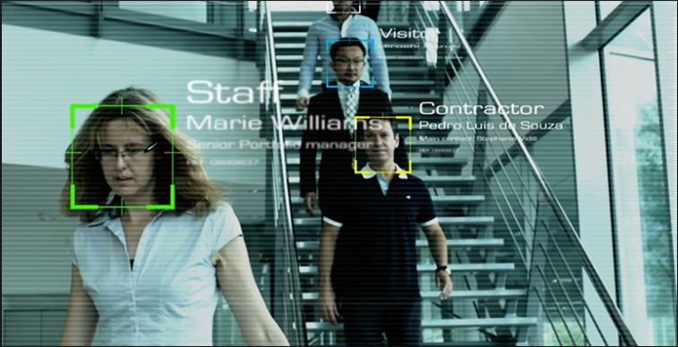
Real world applications
Why we chose this challenge?
Wide applications in….
Facial profiling
Law enforcement
Government
Security
Advertising
Voter fraud elimination
Healthcare
http://www.dqindia.com/wp-content/uploads/2015/05/Face_Recognition_FR_Pic.png

Slide 4
overview
Client hosted on netlify.com at our own domain: http://www.who-really.site/
Server hosted on Heroku, a PAAS
Repositories hosted on GitHub that provide all code
Features analyzed: gender, ethnicity, & age
Also a command line interface that connects to hosted server
Results sent back in JSON form and shown to the user in the format: { feature: result feature: result feature: result }

Slide 5
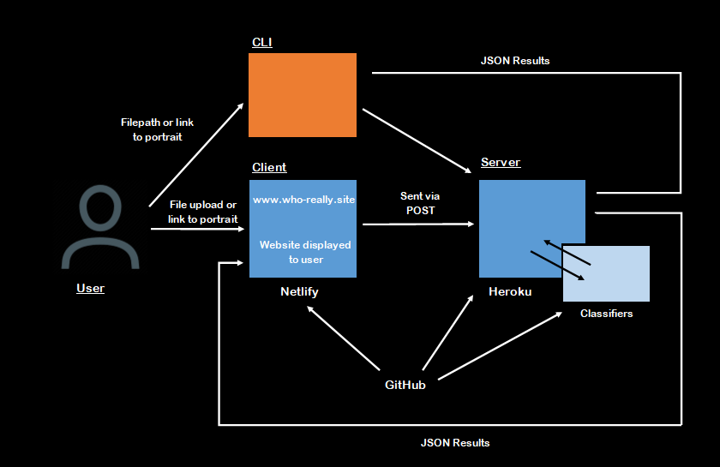
How it works
Five GitHub repositories
Server
Client (website)
CLI
Classifiers
Documentation & wiki

Slide 6
how to use it
Visit client at http://www.who-really.site/
Select image either by uploading from user’s file system or link (TO IMAGE ONLY, not full site)
Possible ways to get image url:
right click, “copy image [URL, location, address]”
open an image alone in a new tab and copy the page’s URL
Send away
Receive our system’s best guess at facial recognition of features

Slide 7
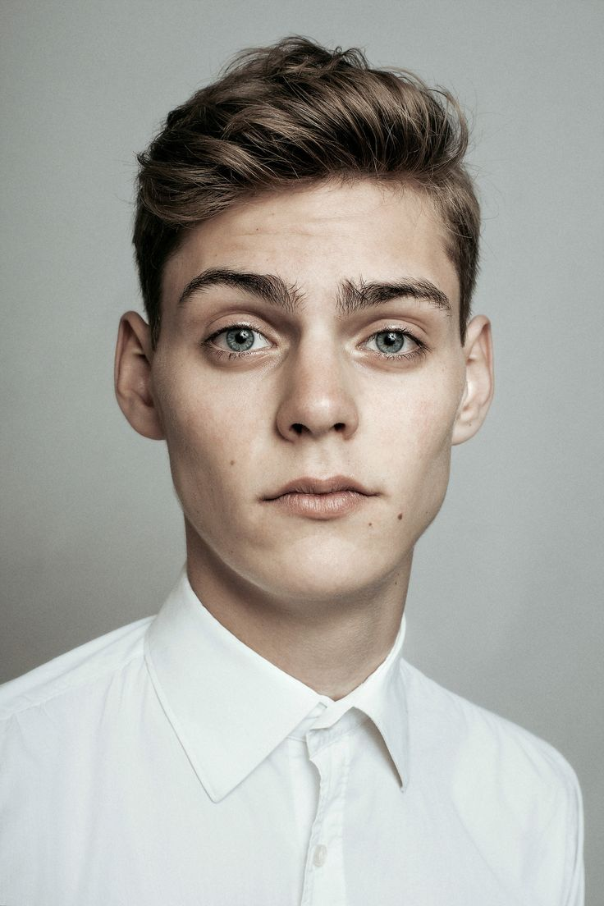
Criteria for portrait
Portrait criteria:
less than 1/3 face covered by hair
facing camera
shoulders up
human…not reptiles or toasters, pls
https://i.pinimg.com/736x/66/c2/97/66c297f1dcd085d2304f63c5ed612c0a--beauty-portrait-male-portraits.jpg

Slide 8
video demo
https://www.youtube.com/watch?v=fC8YeJNhEFo&t=7s

Slide 9

classifiers and training, tooling
Machine learning, neural networks: Python 3, Keras, Tensorflow
The training process, time
Client-facing application: Netlify, namecheap.com, AJAX, HTML
Server: Python 3
Source code: GitHub
Response: JSON
https://www.sololearn.com/Icons/Courses/1073.png

Slide 10

Issues
Docker
Environment setup
Ethnicity classifier
Data set, accuracy
Neural nets on GPUs
Cost
Resource costs
Security measures

Slide 11
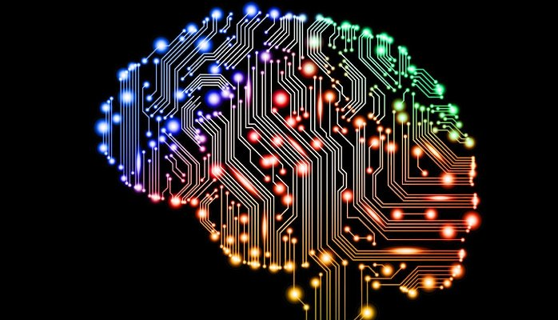
Learning & growing
Machine learning concepts and use
GitHub use and organization
Working cross-continental
Teamwork and communication
Web hosting and various PAAS
SCRUM

Slide 12
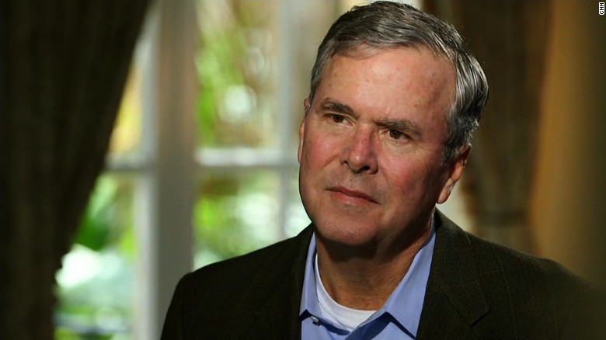
We’re done now
Please clap

